Slide 1


Applications of Acoustic Metamaterials
Ed Stokes, ECE Professor
Ryan Hill, ECE Graduate Student
Matias Mendieta, ECE Undergraduate Student

Slide 2
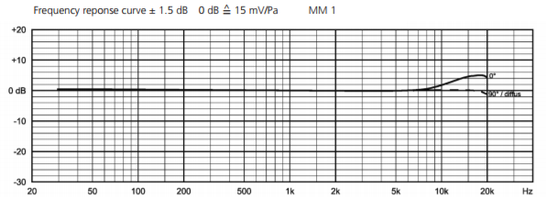
Capabilities of the Lab - Hardware
“Quiet Box” - ETS Lindgren SD Acoustic Chamber
Dimensions:
2ft X 2ft X 2ft
Features:
Testing Frequency > 500 Hz
AS-A504 Walls
Beyerdynamic Measurement Microphone 1 (MM1)
Specifications:
Frequency Response: 20 Hz - 20,000 Hz
Omnidirectional Polar Pattern
3. Avantone Mixcube Active Full-Range Reference Monitor
Specifications:
Frequency Response: 90 Hz - 17,000 Hz
Noise: S/N -113 dB
Sensitivity: .775 Vrms

Slide 3
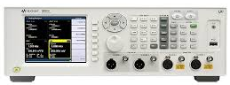
Capabilities of the Lab - Hardware
4. Agilent U8903A Audio Analyzer
What is it?
An instrument that takes measurements of different Acoustic Metrics, such as, level, gain, noise, frequency response, distortion, and other acoustic metrics.
Specifications:
Generator:
Frequency Range: 5 Hz to 80 KHz +/- 0.0005 %
Output Level Range: 0 V to 16 or 8 Vrms
Waveforms: Sine, Square, Arbitrary, “Noise”
Analyzer:
Frequency Range: 10 Hz to 100 KHz +/- 0.0005 %
Measurement Modes: AC Level, DC Level, SINAD, etc
AC Level Range: <1 uV to 140 Vrms +/- 1 %
Audio Filters: Low Pass, High Pass, User-defined Filter
Features:
RF Audio Testing Capabilities (Cellphone, Bluetooth, etc)

Slide 4
Capabilities of the Lab - Software
Modeling and Analytical Software
COMSOL Multiphysics 5.3
Acoustics Module
Computational Fluid Dynamics (CFD) Module
MathWorks MATLAB R2017b
Hardware Control Software
National Instruments LabVIEW 2017
Used to take measurements from the Audio Analyzer
Professional Digital Audio Workstation (DAW)
Pro Tools 12.8
Pro Tools is software designed for recording, editing, and producing audio files.

Slide 5
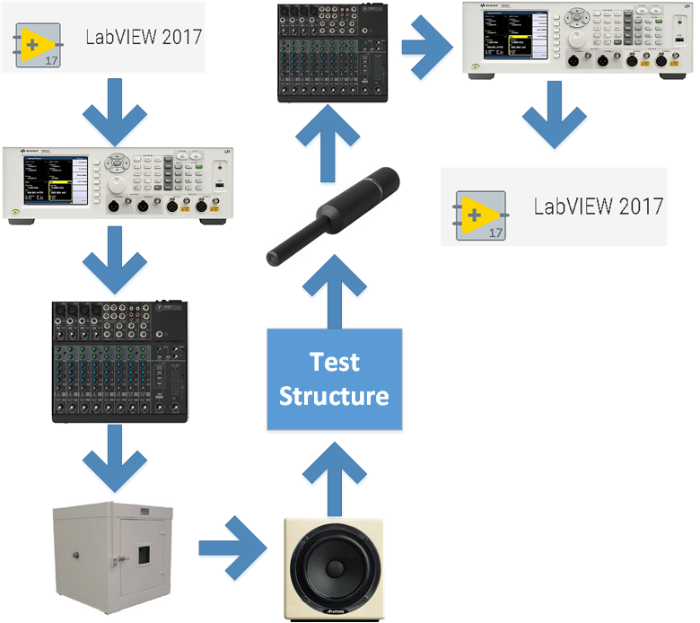
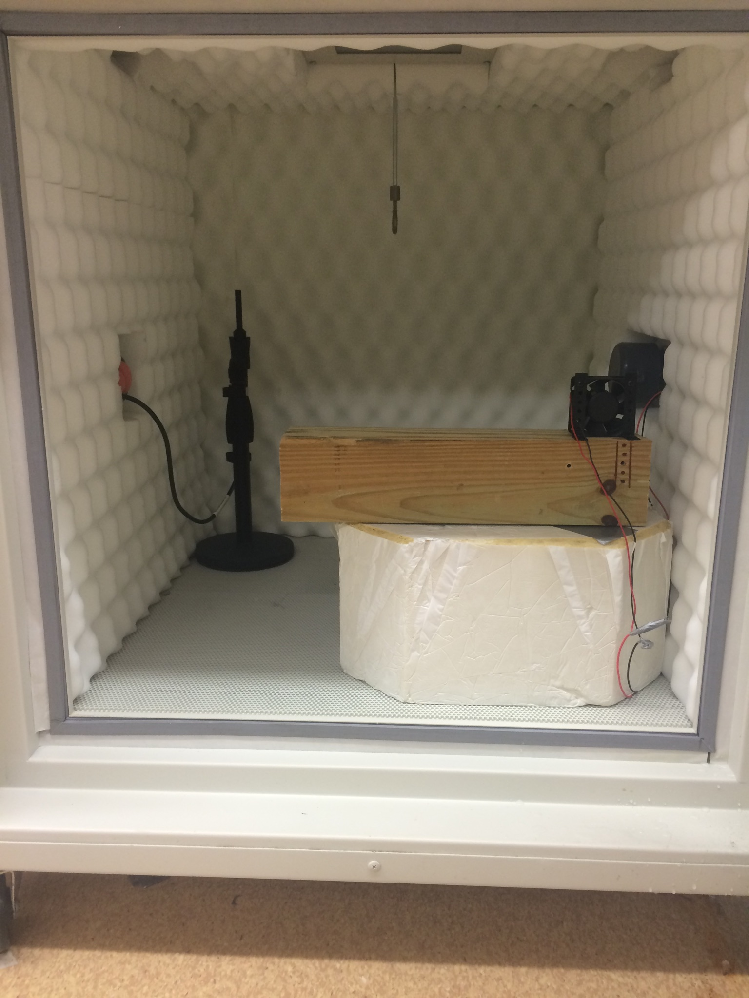
Experimental Lab Setup

Slide 6
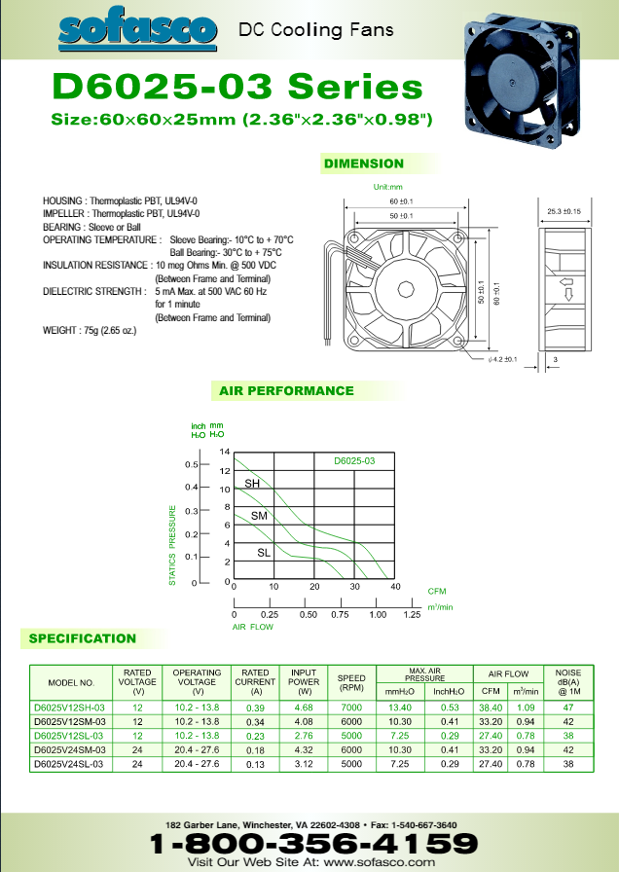

Definition of the Problem and The Fan
Problem: The Fan makes noise.
Solution: Remove the noise associated with the fan’s Resonance Frequencies.
Goal: Develop acoustic metamaterials for that purpose.
Fan Specifications:
Fan Model: D6025V12SH-03
How many blades? Seven
12 V Noise:
12 V Noise with 803 Tone:

Slide 7
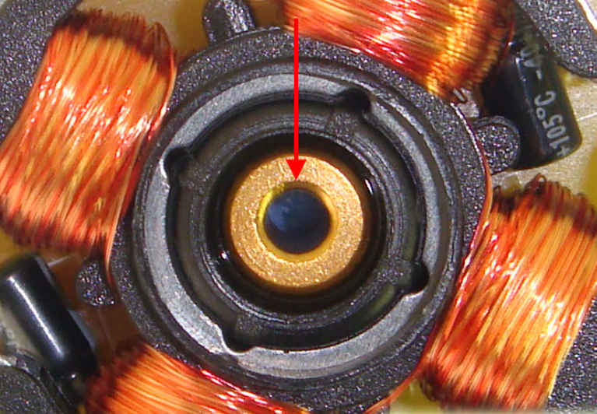
Sources of Fan Resonance
Sources of Fan Resonance
1.) Fan Rotation Frequency (SBRF)
Fan RPM / 60 (s/min) = 7000 RPM / 60 (s/min) = 117 Hz
2.) Blade Pass Frequency (BPF)
BPF = [( (No. of Blades) * Fan RPM) 60 (s/min)] = 817 Hz
Sleeve Bearing
BPF Harmonics | 817 Hz | 1634 Hz | 2451 Hz | 3268 Hz

Slide 8
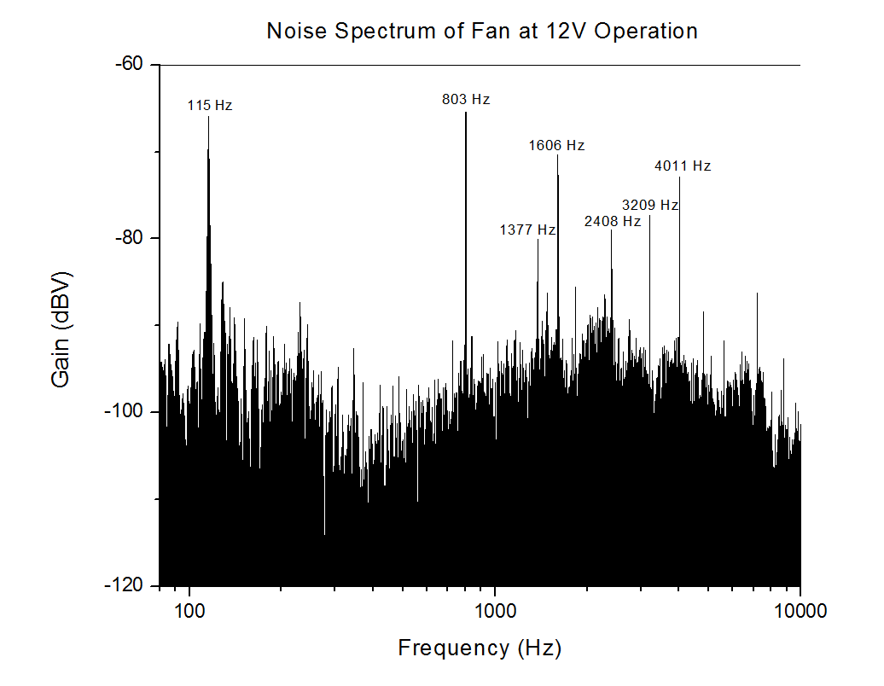
Fan Noise Characteristics
Peak # | What is it? | Calculated | Measured
1 | Fan Harm. #1 | 117 Hz | 115 Hz
2 | BPF Harm. #1 | 817 Hz | 803 Hz
3 | We aren’t sure | N/a | 1377 Hz
4 | BPF Harm. #2 | 1634 Hz | 1606 Hz
5 | BPF Harm. #3 | 2451 Hz | 2408 Hz
6 | BPF Harm. #4 | 3268 Hz | 3209 Hz
7 | BPF Harm. #5 | 4085 Hz | 4011 Hz

Slide 9
Fan Noise – Peaks vs Voltage Table
% of Spec Voltage (12 V) | Peak 1 (Hz) (Measured) | Peak 2 (Hz) (Measured) | Peak 1 (Hz) (Calculated | Peak 2 (Hz) (Calculated) | P2/P1 (Number of Blades = 7)
- 50% (6 V) | 59 | 421 | 58 | 408 | 7.14
- 10% (10.8 V) | 106 | 734 | 105 | 735 | 6.92
- 5% (11.4 V) | 112 | 775 | 111 | 776 | 6.92
(12 V) | 115 | 803 | 117 | 817 | 6.98
+ 5% (12.6 V) | 120 | 832 | 123 | 858 | 6.93
+ 10% (13.2 V) | 124 | 865 | 128 | 898 | 6.97

Slide 10
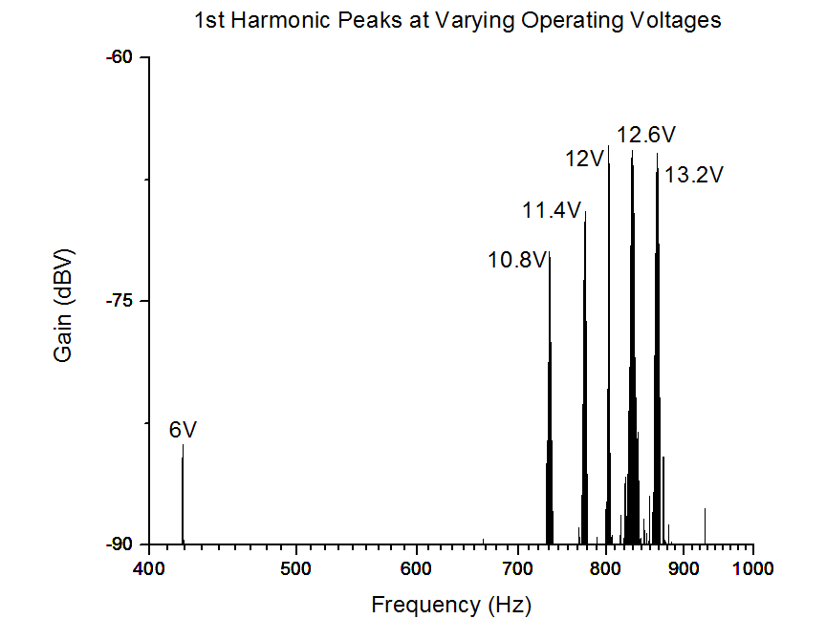
Fan Noise- 1st Harmonic Peaks Graph

Slide 11
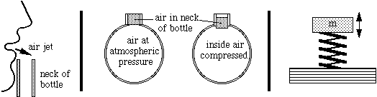
Helmholtz Resonator
What is a Helmholtz Resonator?
A cavity containing a fluid (usually air) with a hole in the cavity, where a neck is attached.
The neck allows flowing fluid to enter the cavity.
This is the phenomena that occurs when blowing over a glass bottle is a result of the bottle being a Helmholtz Resonator.
This can be roughly modeled as a simple mass spring system or an RLC circuit.

Slide 12
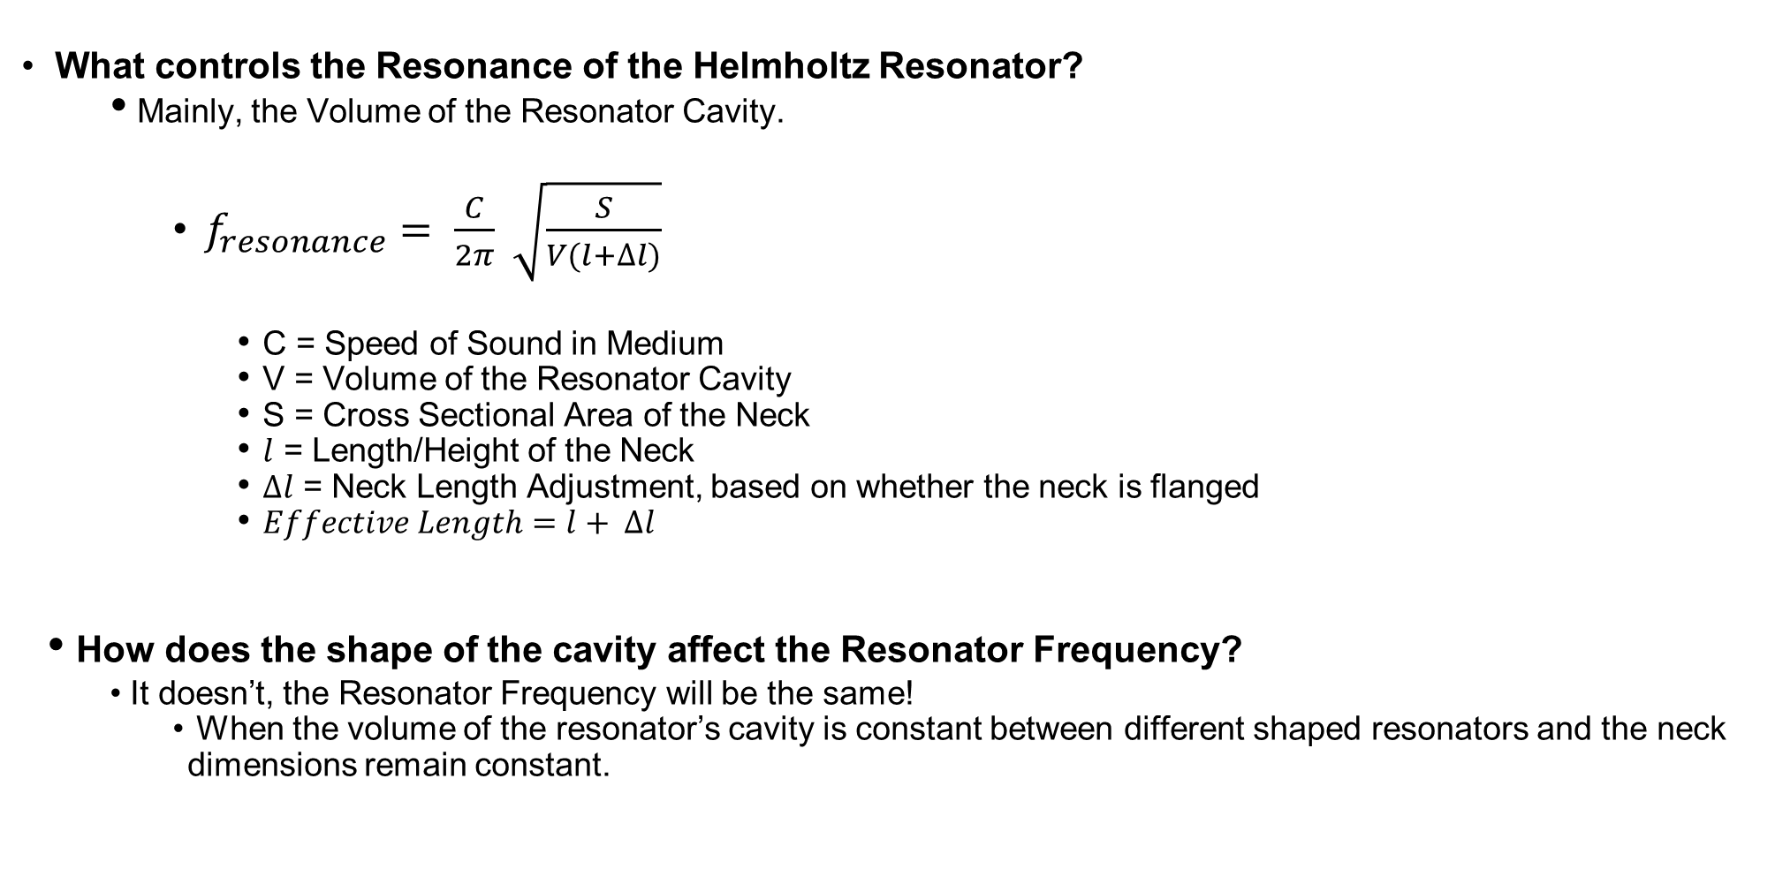
Helmholtz Resonator Design
What controls the Resonance of the Helmholtz Resonator?
Mainly, the Volume of the Resonator Cavity.
$f_{resonance}= \frac{C}{2π} \sqrt{\frac{S}{V(l+∆l)}}$
C = Speed of Sound in Medium
V = Volume of the Resonator Cavity
S = Cross Sectional Area of the Neck
$l$ = Length/Height of the Neck
$∆l$ = Neck Length Adjustment, based on whether the neck is flanged
$Effective Length=l+ ∆l$
How does the shape of the cavity affect the Resonator Frequency?
It doesn’t, the Resonator Frequency will be the same!
When the volume of the resonator’s cavity is constant between different shaped resonators and the neck dimensions remain constant.
Notes:
.6a -> unflanged

Slide 13
Helmholtz Resonator Design
Approach:
Pick a lower voltage peak and large resonator (relative to future planned size) to test the simulation capability of Comsol.
Focus on choosing practical shape and volume for the cavity for design.
Eventually, use Spec. voltage with smaller 3D printed resonators

Slide 14
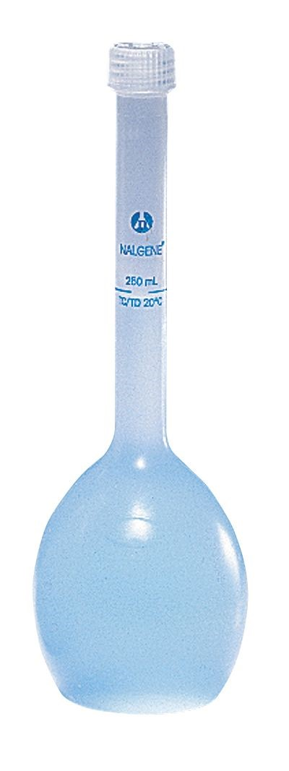
Helmholtz Resonator with No Flow
What physical object is my Helmholtz Resonator model based on?
A Chemical Flask
Dimensions of the Flask:
Total Volume = 50 mL
Length of Neck ~= 10 cm
Diameter of Neck ~= .7 cm
Resonator Volume ~= 46.51 mL
What is the target Frequency?
Half Voltage Spec. (6V) Resonance Frequency ~= 421 Hz
Calculated Required Volume for Flask:
13.9 % of 14.51 mL = 6.41 mL
Flask Volume can be changed by adding water

Slide 15
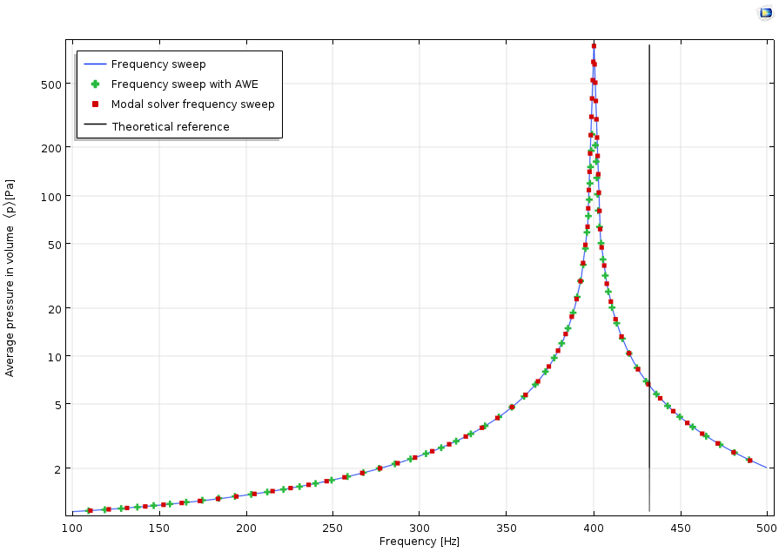
Helmholtz Resonator with No Flow
Comsol Resonance Frequency Results
Theoretical (Design) Resonance Frequency = 421 Hz
Simulated Resonance Frequency ~= 400 Hz
Notes:
http://www.acoustic-glossary.co.uk/sound-pressure.htm

Slide 16
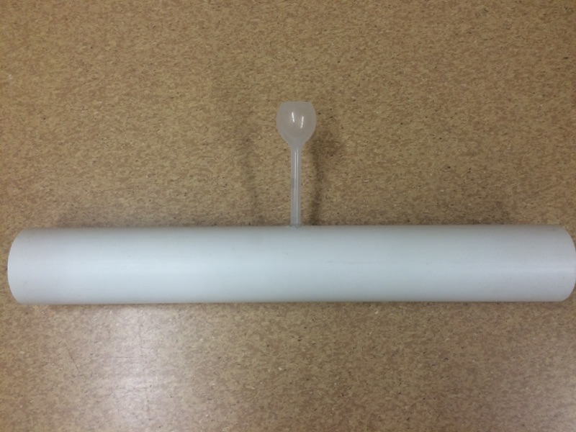
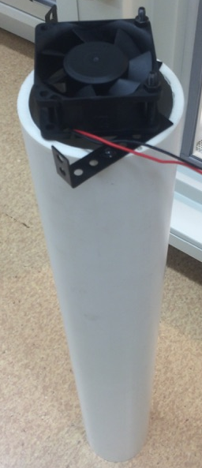
Single Helmholtz Resonator with Flow
Physical Testing Approach
Part 1
Establish a reference, by measuring the sound at the end the channel (pipe) with the fan attached to opposite side. (Note: the resonator is not attached and the hole is sealed.
Part 2
Carefully attach the resonator to the pipe without moving the pipe’s location in the “quiet box”.
Part 3
Subtract the reference data from the resonator data and then, analyze the results. Compare it to the simulated results from Comsol.

Slide 17
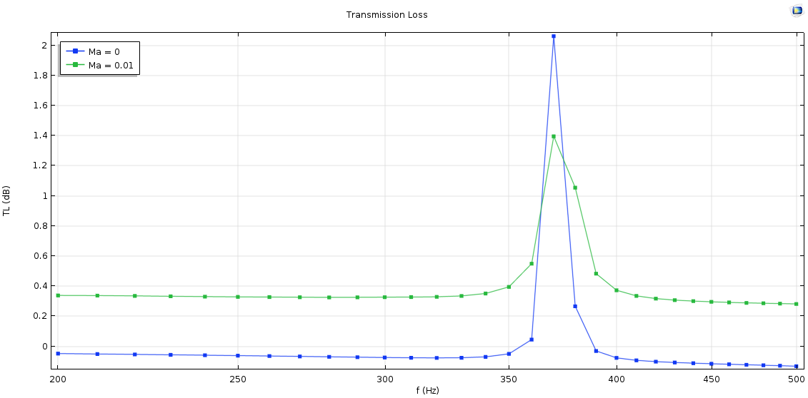

Comsol Single Helmholtz Resonator with Flow
Comsol Model
Physical Model Parameters
Channel (pipe): 2 ft (length) by 3.5 (diameter)
Resonator at the midsection of the pipe
Bulk Modulus: $∞$ (incompressible)
Mass Flow Rate: 3.97 m/s
Mach Number (Ma): .0115
Compressible Flow (Ma < .3)

Slide 18
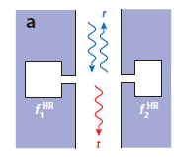
Review of Peng and Zhang Model
Coupled Helmholtz Resonator
Two Helmholtz Resonators placed across from each.
Hybrid Resonance Frequency = f0 = (f2 - f1)/2
For example:
Assume, Cavity shape is a cylinder
f1 = 30,000 Hz, f2 = 31,600 Hz, f0 = 800 Hz
Neck Radius = .5 cm, Neck Length = .4 cm, radius cylinder = Neck Length / 2 = .2 cm (Same for All)
h1 = .5 cm, h2 = .46 cm
The height of a single resonator for a resonance frequency of 800 Hz = 7.27 m
Conclusion: We can use the Coupled Helmholtz Resonator method to decrease the size of the resonator.
Yang and Sheng, "Sound Absorption Structures:From Porous Media to Acoustic Metamaterials", Annu. Rev. Mater. Res. 2017. 47:83–114.

Slide 19
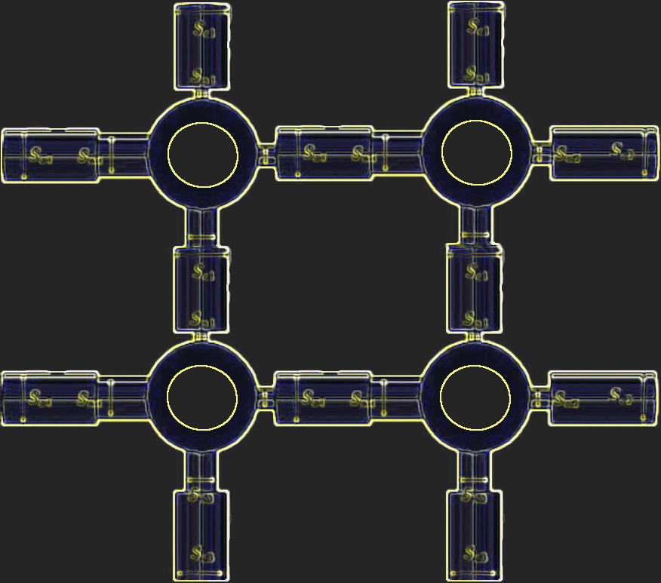
What are we going to do next?
Single Helmholtz Resonator with Flow
Verify the current comsol model.
Adjust comsol model for 12 V peak and compare to a new physical model.
Explore Two or more Helmholtz Resonator Setups (with Flow)
Investigate the effect of multiple Helmholtz Resonators.
Apply Peng and Zang’s Coupled Helmholtz Resonator approach.
Customizable Multiple Resonator Cubes
Thanks to Richard DeSalvo, Erin Sharma, and others at Harris for their advice and assistance

Slide 20
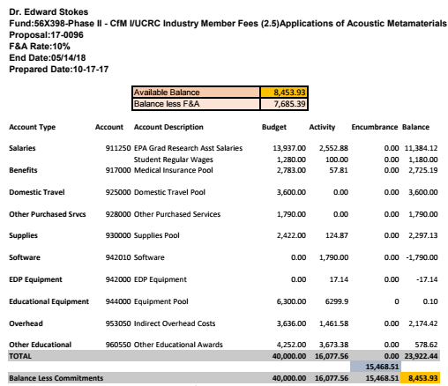
Budget

